Slide 1



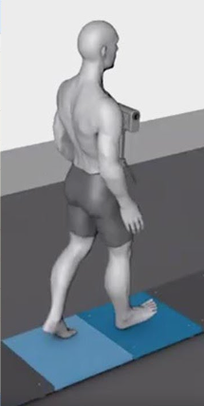
Enhancing Maternal Balance: Comparative Analysis
of Plantar Pressure Distribution Across and Visual
Feedback Within Pregnancy Trimesters
AUTHORS
Minahil Kamal
35377@students.riphah.edu.pk
Aleena Kamal
aleenakamal25@gmail.com
Faisal Amin
faisal.amin@riphah.edu.pk
Azka Abid
azkaabid0@gmail.com
Ayesha Imtiaz
ayeshaimtiaz634@gmail.com
Shoaib Zafar
shoaib.zafar@riphah.edu.pk
Hamza Ghazanfar Toor
hamza.ghazanfar@gmail.com

Slide 2



Table of Content
I
01.
Introduction
02.
Problem Statement
03.
Objective and Motivation
I
04.
Novelity
I
05.
Methodology
I
06.
Findings and Graphical Results
I
07.
Analysis and Conclusion
I
08.
Limitations
I
09.
Future Recommendation

Slide 3

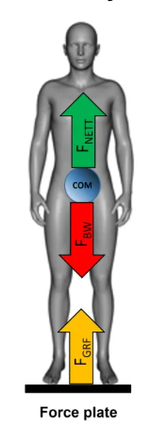
INTRODUCTION
Pregnancy induces notable biomechanical changes, influencing maternal balance and stability.
Research shows that around 30-60% of pregnant women experience balance issues, raising risks of falls with potential complications for maternal and fetal health.
Various anatomical, physiological, and hormonal changes in a woman's body due to pregnancy.
Alterations in balance and postural control due to these changes
Hormonal changes contribute to joint laxity, ligamentous laxity, and alterations in muscle tone, impacting balance.
The growing fetus shifts the woman's center of gravity forward.
The COP provides quantitative data about the distribution of forces exerted by the body on the support surface.
It is influenced by various factors such as muscle activity, joint stability, proprioception, and visual feedback.

Slide 4
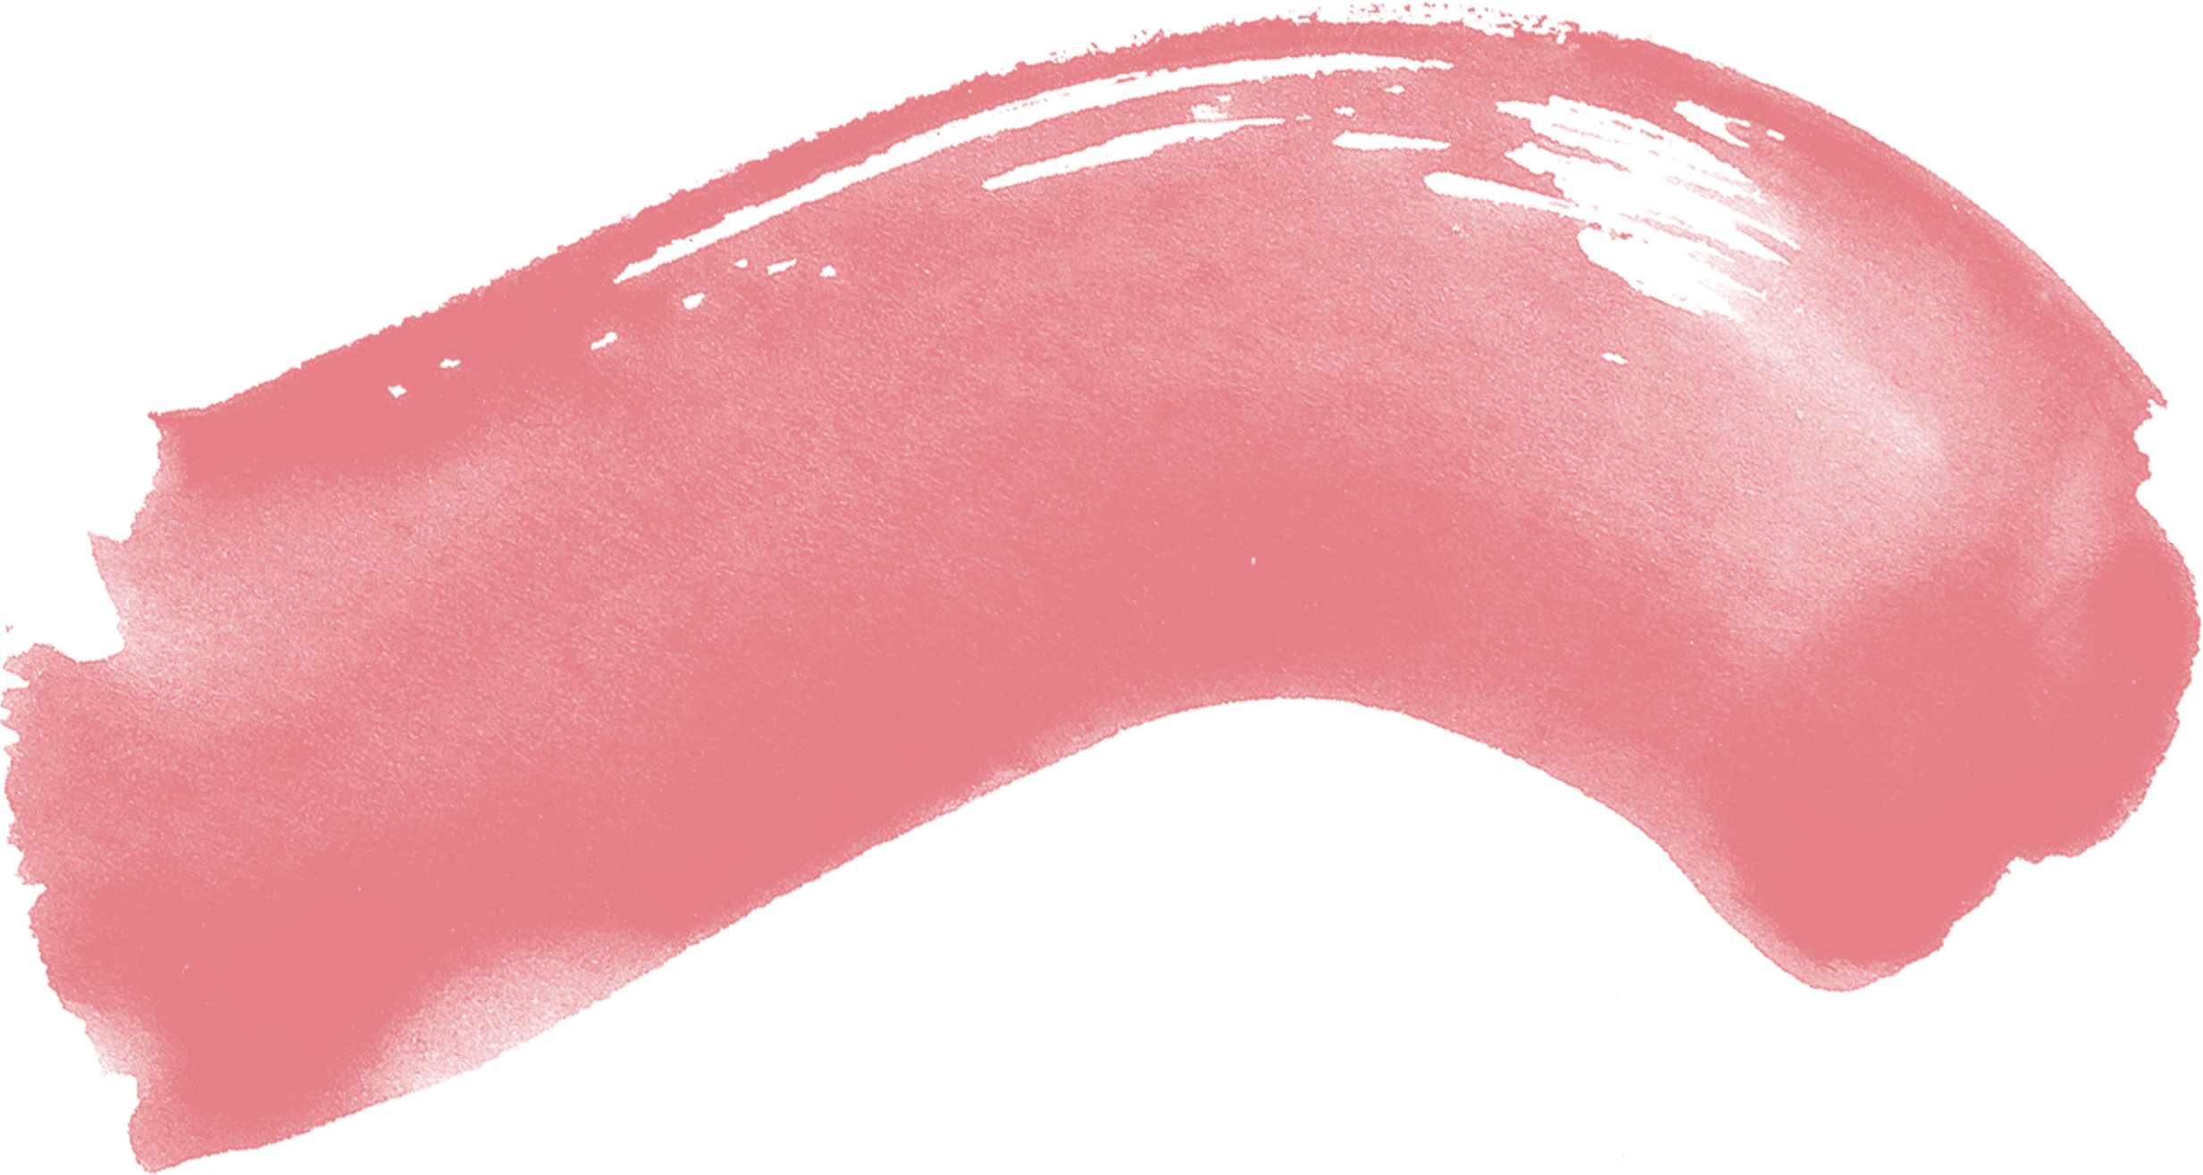

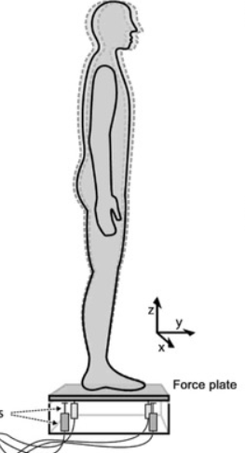
PROBLEM STATEMENT
Studies on pregnancy biomechanics predominantly focus on gait changes, weight distribution, and musculoskeletal adaptation but lack depth in trimester-specific balance evaluations, particularly under varied visual feedback conditions.
This gap restricts healthcare providers from fully understanding the evolving balance dynamics and associated fall risks throughout pregnancy stages.
How to investigate the balance and force distribution in pregnant females during different trimesters?
How to compare the COP measurements with eyes open and eyes closed within the same trimester and between different trimesters?

Slide 5
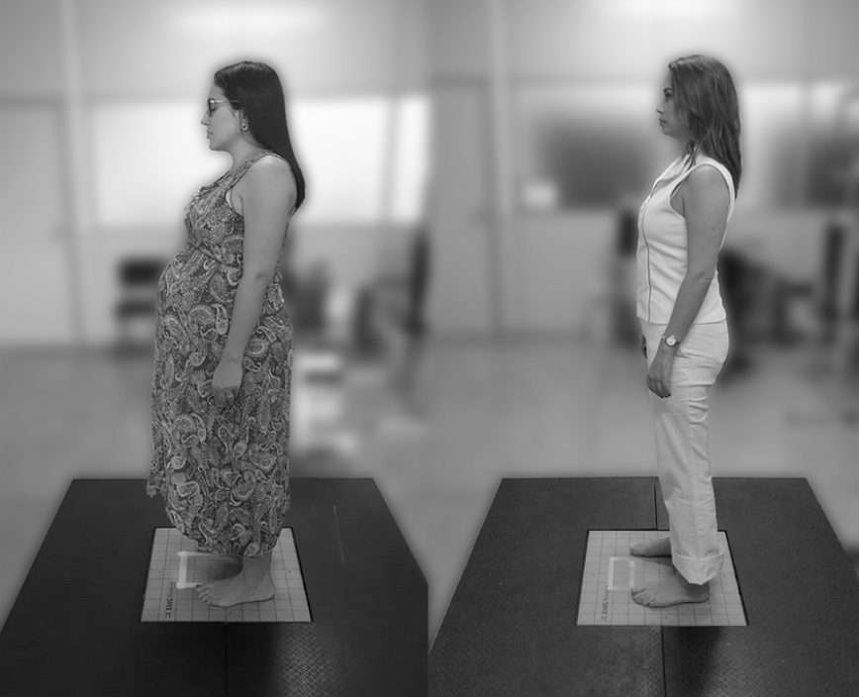
OBJECTIVE AND MOTIVATION
To provide valuable insights into the effects of pregnancy on postural stability.
To utilize Center of Pressure (COP) analysis with integrated visual feedback to comprehensively examine trimester-specific balance adjustments, by integrating ANOVA to identify significant differences in postural stability between open and closed-eye conditions across trimesters.
Motivated by the critical need for overcoming the gap that restricts healthcare providers from fully understanding the evolving balance dynamics and associated fall risks throughout pregnancy stages.
Picture taken from online source. Own subjects’ privacy concerns considered!

Slide 6

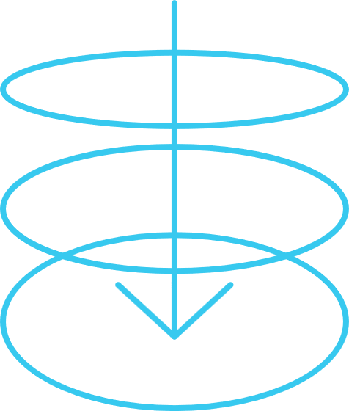
NOVELITY IN OUR WORK
Integrated Visual Feedback: Uniquely incorporates visual feedback to assess its direct influence on balance across pregnancy trimesters, providing a comprehensive view of sensory reliance during pregnancy.
Extended Observation Period: Balance is analyzed for a longer duration (two minutes, split between open and closed-eye conditions), offering more reliable insights into the role of vision in maintaining postural stability during pregnancy.
Trimester-Specific Analysis: Breaks down balance dynamics for each trimester, using a large sample size (147 pregnant women) to capture trimester-specific changes in Center of Pressure (COP) and sway, revealing trends not previously documented.
Advanced Methodology: Application of ANOVA for robust statistical analysis of trimester-specific balance variations, for precise identification of high-risk trimesters for balance issues.

Slide 7

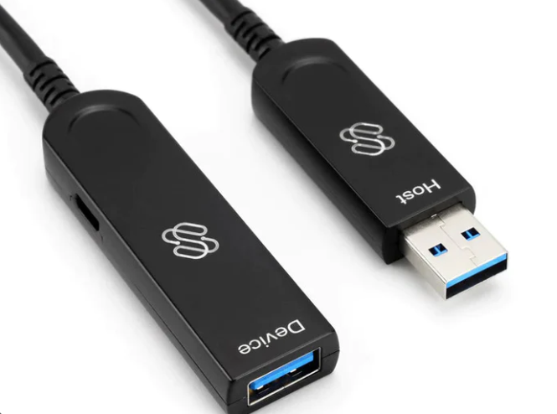
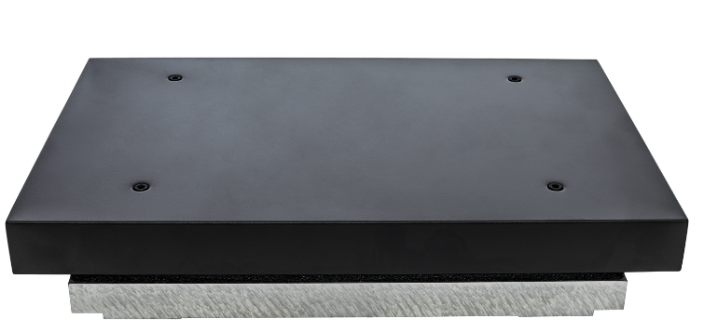
METHODOLOGY
DATA COLLECTION
TOOL:
FORCE PLATFORM AND USB LINK
SOFTWARE:
PASCO CAPSTONE
SAMPLE SIZE:
147 (49 for each trimester)

Slide 8
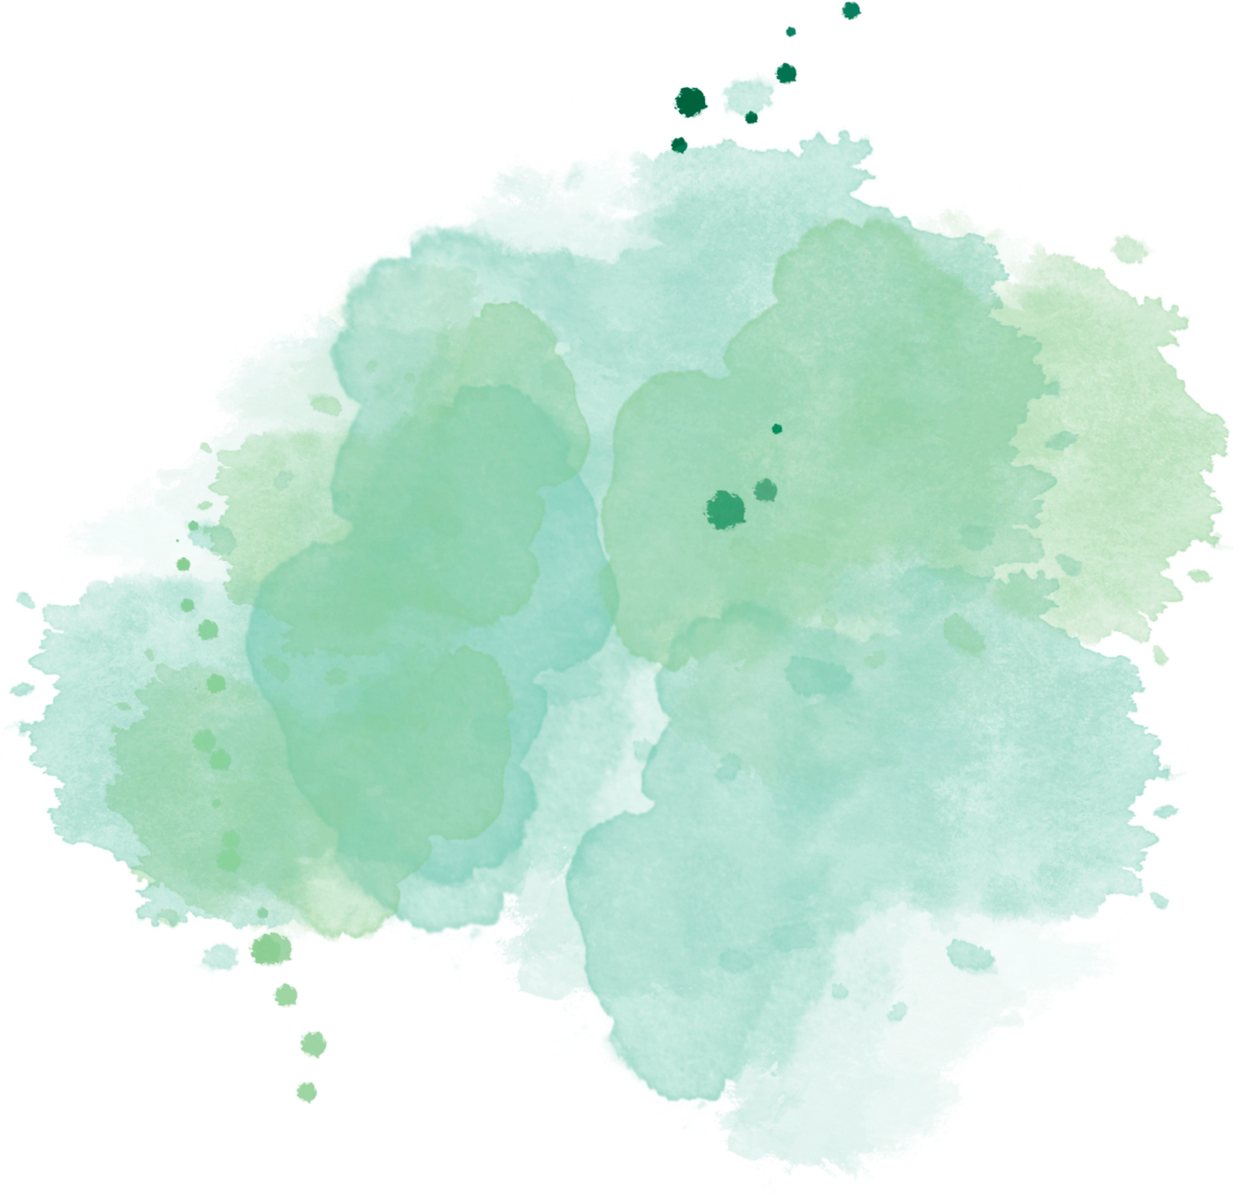

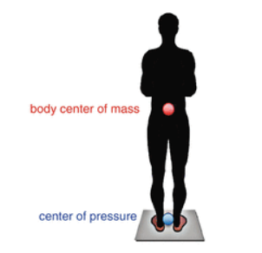

PROTOCOL OBSERVED
1
Female had to stand straight
Female had to look straight at eye level with arms on sides
2
Female could not talk and move
3
Female could not open her eyes in 2nd run
4
5
Platform was tared every time

Slide 9
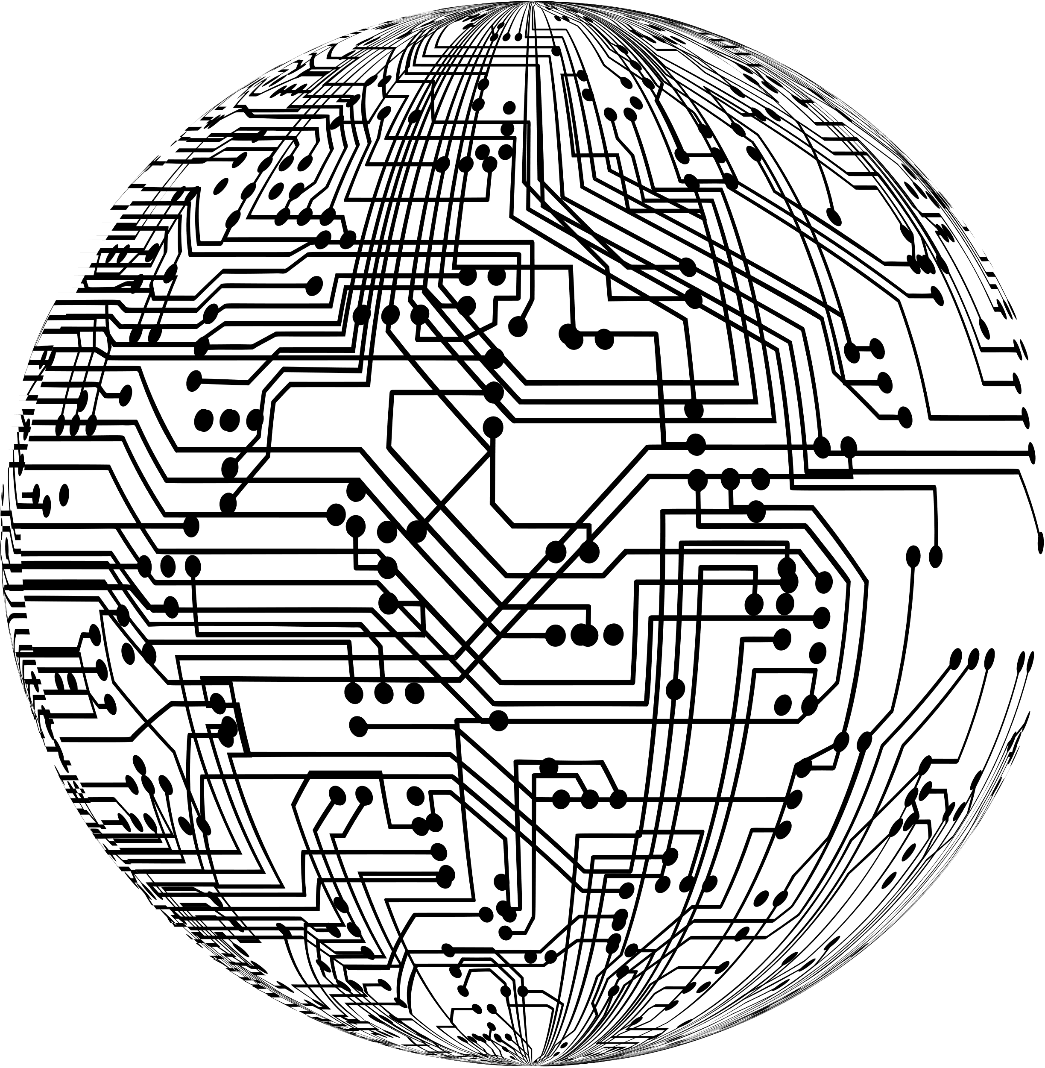
METHOD
5
Statistical Analysis
The collected data has been statistically analyzed using ANOVA test
4
Trimester-to-Trimester Comparison
COP measurements are compared between different trimesters
3
Trimester-wise Analysis
COP measurements within the same trimester is compared between eyes open and eyes closed conditions one minute each
2
Balance Assessment
The participants' balance was assessed using force plates or pressure-sensitive platforms.
1
Participant Selection
Pregnant females in different trimesters (e.g., first, second, and third trimesters) were recruited for the study

Slide 10

VARIABLES
Independent Variables
Dependent Variables
1
2
3
4
Condition
Trimester
Balance
Force Distribution
With eyes open and with eyes closed
Different trimesters of pregnancy
COP measurements or postural stability assessments
Indicator of postural control and stability

Slide 11
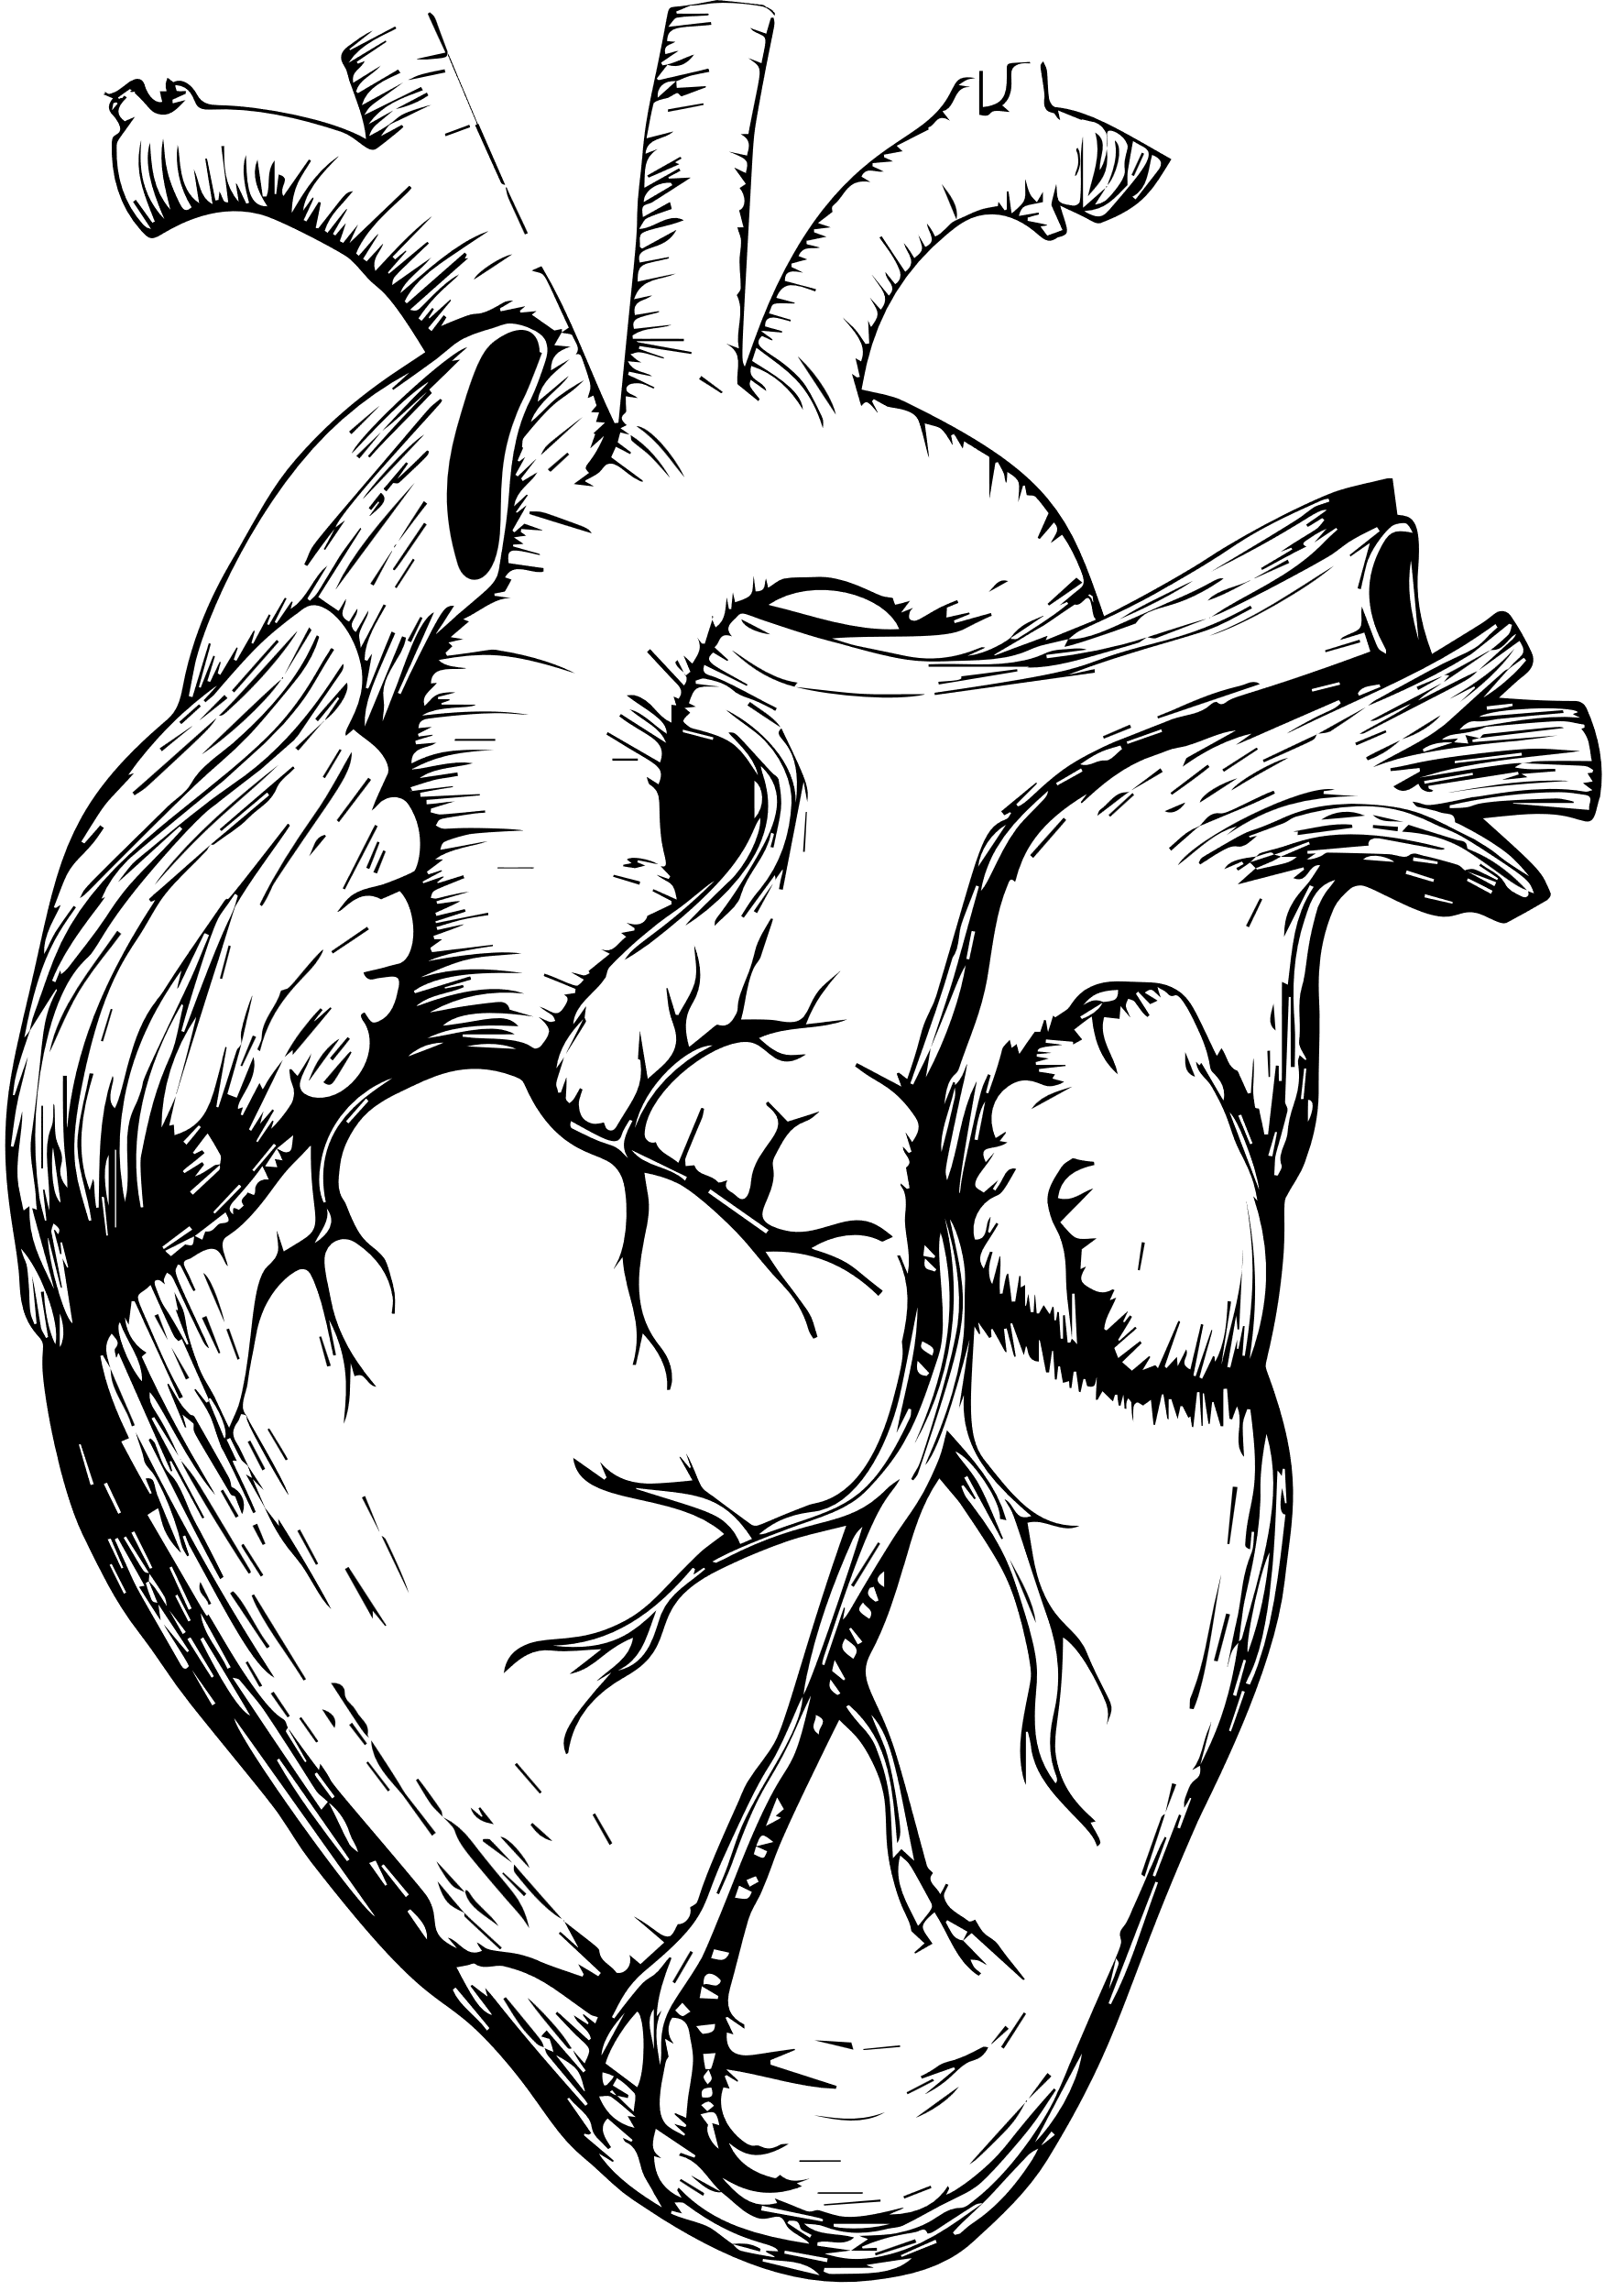
FINDINGS
Medio- Lateral Standard Deviation
[EO_T1]vs[EC_T1] = p< 0.0026
[EO_T2]vs[EC_T2] = p< 0.0109
[EO_T3]vs[EC_T3] = p< 0.0005
Antero- Posterior Standard Deviation
#
[EO_T1]vs[EC_T1] = p< 0.0227
[EO_T2]vs[EC_T2] = p< 0.0060
[EO_T3]vs[EC_T3] = p< 0.0208
Total Medio Lateral Sway
[EO_T1]vs[EC_T1] = p< 0.0001
[EO_T2]vs[EC_T2] = p< 0.0400
[EO_T3]vs[EC_T3] = p< 0.0013
04
Total Antero Posterior Sway
[EO_T1]vs[EC_T1] = p< 0.0060
[EO_T2]vs[EC_T2] = p< 0.0989
[EO_T3]vs[EC_T3] = p< 0.0379

Slide 12
FINDINGS
05
PAIRWISE COMPARISONS (TOTAL AP SWAY)
[EO_T1]vs[EO_T2] PAIRED = p< 0.4676
[EO_T1]vs[EO_T3] PAIRED = p< 0.2521
[EO_T1]vs[EC_T1] = p< 0.0060
[EO_T1]vs[EC_T2] = p< 0.0020
[EO_T1]vs[EC_T3] = p< 0.0001
[EO_T2]vs[EO_T3] PAIRED = p< 0.6977
[EO_T2]vs[EC_T1] = p< 0.1548
[EO_T2]vs[EC_T2] = p< 0.0989
[EO_T2]vs[EC_T3] = p< 0.0144
[EO_T3]vs[EC_T1] = p< 0.3206
[EO_T3]vs[EC_T2] = p< 0.2197
[EO_T3]vs[EC_T3] = p< 0.0379
[EC_T1]vs[EC_T2] PAIRED = p< 0.7157
[EC_T1]vs[EC_T3] PAIRED = p< 0.0676
[EC_T2]vs[EC_T3] PAIRED = p< 0.2729

Slide 13
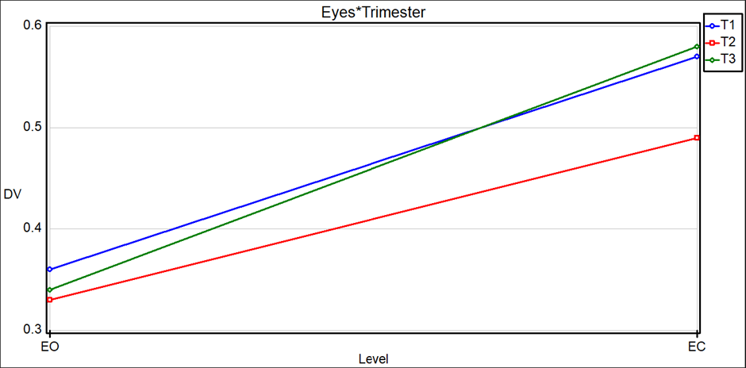
GRAPHICAL RESULTS
Medio Lateral STD DEV

Slide 14
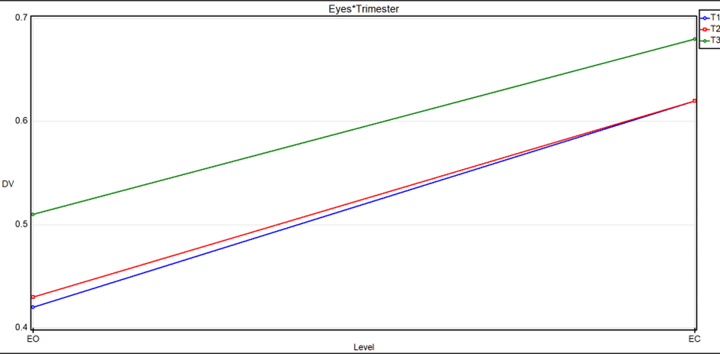
Antero Posterior STD DEV

Slide 15
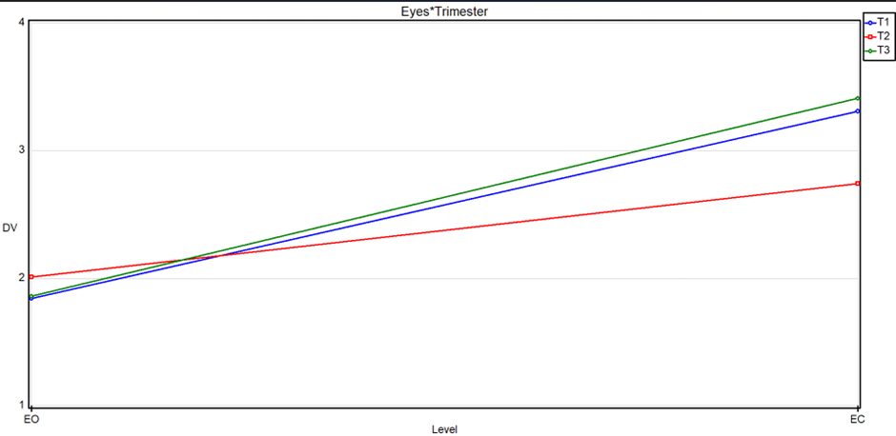
Total Medio Lateral SWAY

Slide 16
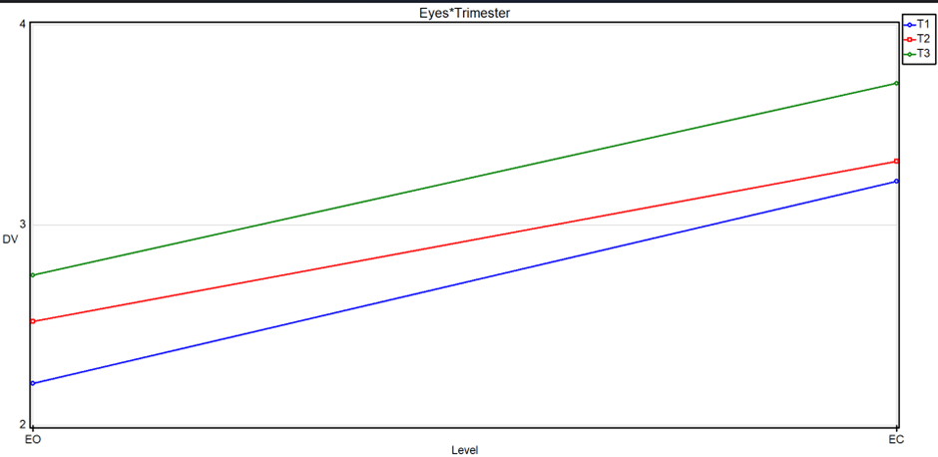
Total Antero Posterior SWAY

Slide 17

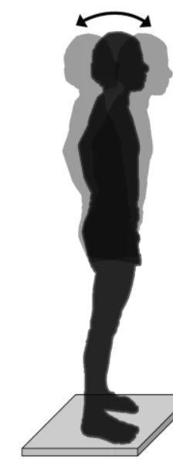

ANALYSIS AND CONCLUSION
Greater changes in all Medio Lateral Standard Deviation, Antero Posterior Standard Deviation, Total Medio Lateral SWAY, Total Antero Posterior SWAY between eyes opened and closed conditions within same trimesters.
Significant deviations between different trimesters especially between first and third

Slide 18
IMPLICATIONS
1
2
3
4
5
Understanding Pregnancy-related Balance Changes
Identifying Fall Risk Factors
Enhancing Prenatal Care
Informing Rehabilitation and Exercise Programs
Advancing Research and Knowledge
How balance and force distribution vary across different trimesters of pregnancy and under different visual conditions
Balance disturbances and falls are significant concerns during pregnancy
Identify individuals who may require additional support or interventions to maintain their balance and overall
Such programs can contribute to reducing the risk of falls and promoting overall physical health during pregnancy
It can contribute to a better understanding of the underlying mechanisms involved in balance changes during pregnancy

Slide 19
Knowledge of Pregnancy-Related Balance Changes:
How pregnancy affects postural control.
Informing Clinical Practice:
Guide evaluations, interventions, and recommendations for maintaining balance and preventing falls during pregnancy.
Identification of Balance Deficits:
Pinpoint specific periods or situations where balance control may be compromised.
05
Supporting Fall Prevention Efforts:
Falls during pregnancy can have adverse consequences for both the mother and the developing fetus
CONTRIBUTIONS
Opening avenues for further research:
The identified gaps and areas of interest can inspire future studies to explore related aspects

Slide 20


LIMITATIONS
Exclusion of Other Sensory Pathways
Focus on Static Posture
Cross-Sectional Design

Slide 21

FUTURE RECOMMENDATION
Comparison with non-pregnant same age-group females
Expanded Sensory Analysis
Longitudinal Studies

Slide 22
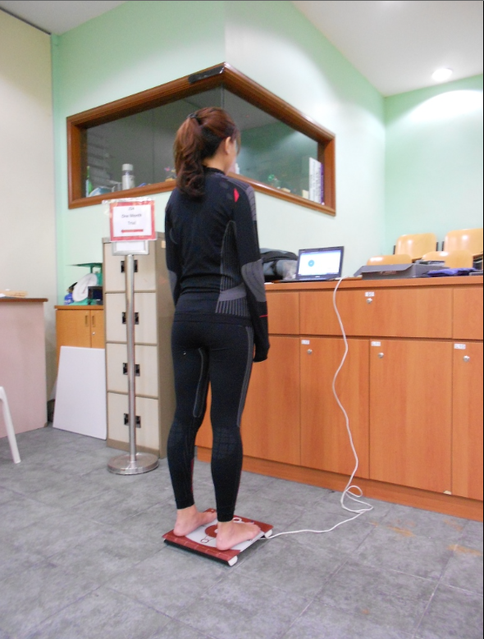


THANKYOU FOR LISTENING
Any Questions ??
Picture taken from online source. Own subjects’ privacy concerns considered!

